Slide 1





Cloud Computing
Fundamentals to Services
Daniel Wagner

Slide 2


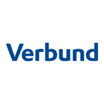


About me
Studies
Computer Science
Computer Science Management
Work
Software Developer
Architect
Consultant, Speaker & Trainer
Volunteer
Founder CoderDojo Wien
Ambassador Youth Hackathon
Affiliations (past & present)

Slide 3
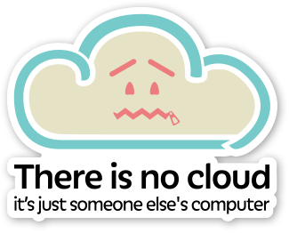
The Cloud Is Just Someone Else's Computer
Notes:
Source: https://medium.com/@storjproject/there-is-no-cloud-it-s-just-someone-else-s-computer-6ecc37cdcfe5

Slide 4
Roadmap
Fundamentals
Service Models
Characteristics
Deployment Models
Adoption
How Azure works
Experimentation
Building Blocks
Portal
Services
Tools
Azure by example
Best practices
Motivation
Governance
Commercial aspects

Slide 5
Fundamentals
Definition of Cloud Computing

Slide 6

Definition of Cloud Computing
NIST SP 800-145
Cloud computing is a model for enabling ubiquitous, convenient, on-demand network access to a shared pool of configurable computing resources (e.g., networks, servers, storage, applications, and services) that can be rapidly provisioned and released with minimal management effort or service provider interaction.
This cloud model is composed of five essential characteristics, three service models, and four deployment models.
Notes:
Source: https://csrc.nist.gov/publications/detail/sp/800-145/final
Image Flaticon.com

Slide 7
Essential Charateristics
Overview

Slide 8

Essential Characteristics
On-demand self-service
A consumer can unilaterally provision computing capabilities, such as server time and network storage, as needed automatically without requiring human interaction with each service provider.
Notes:
Image: Flaticon.com

Slide 9
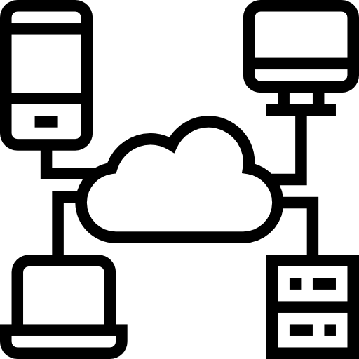
Essential Characteristics
Broad network access
Capabilities are available over the network and accessed through standard mechanisms that promote use by heterogeneous thin or thick client platforms (e.g., mobile phones, tablets, laptops, and workstations).
Notes:
Image: Flaticon.com

Slide 10
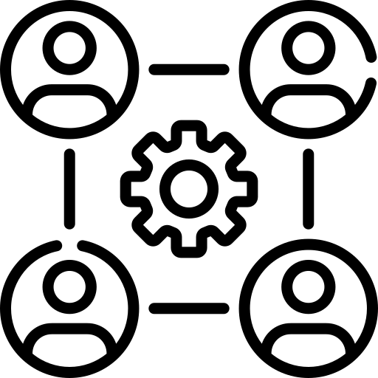
Essential Characteristics
Resource pooling
The provider’s computing resources are pooled to serve multiple consumers using a multi-tenant model, with different physical and virtual resources dynamically assigned and reassigned according to consumer demand. There is a sense of location independence in that the customer generally has no control or knowledge over the exact location of the provided resources but may be able to specify location at a higher level of abstraction (e.g., country, state, or datacenter). Examples of resources include storage, processing, memory and network bandwidth.
Notes:
Image: Flaticon.com

Slide 11

Essential Characteristics
Rapid elasticity
Capabilities can be elastically provisioned and released, in some cases automatically, to scale rapidly outward and inward commensurate with demand. To the consumer, the capabilities available for provisioning often appear to be unlimited and can be appropriated in any quantity at any time.
Notes:
Image: Flaticon.com

Slide 12
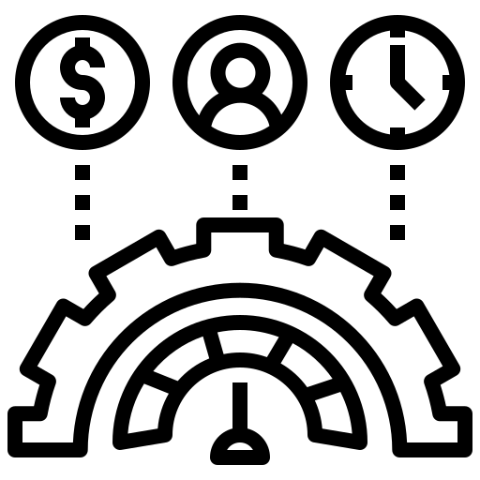
Essential Characteristics
Measured service
Cloud systems automatically control and optimize resource use by leveraging a metering capability at some level of abstraction appropriate to the type of service (e.g., storage, processing, bandwidth, and active user accounts). Resource usage can be monitored, controlled, and reported, providing transparency for both the provider and consumer of the utilized service.
Notes:
Image: Flaticon.com

Slide 13
Essential Characteristics
Summary
These specified organizational and technological characteristics have to be met by provider offerings to be qualified as cloud service.
They are independent of specific deployment or service models.

Slide 14
Deployment Models
Overview

Slide 15

Deployment Models
Private cloud
The cloud infrastructure is provisioned for exclusive use by a single organization comprising multiple consumers (e.g., business units). It may be owned, managed, and operated by the organization, a third party, or some combination of them, and it may exist on or off premises.

Slide 16
Deployment Models
Private cloud
Physically isolated or as Virtual Private Cloud (VPC) by provider.
E.g. Azure Stack, AWS VPC, Google VPC, …

Slide 17
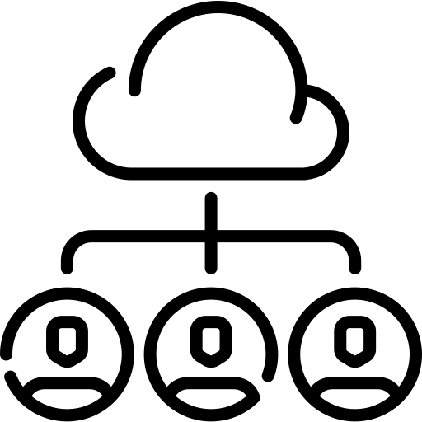
Deployment Models
Community cloud
The cloud infrastructure is provisioned for exclusive use by a specific community of consumers from organizations that have shared concerns (e.g., mission, security requirements, policy, and compliance considerations). It may be owned, managed, and operated by one or more of the organizations in the community, a third party, or some combination of them, and it may exist on or off premises.

Slide 18
Deployment Models
Community cloud
Azure for US Government
ARZ – Allgemeines Rechenzentrum
BRZ - Bundes Rechenzentrum

Slide 19

Deployment Models
Public cloud
The cloud infrastructure is provisioned for exclusive use by a specific community of consumers from organizations that have shared concerns (e.g., mission, security requirements, policy, and compliance considerations). It may be owned, managed, and operated by one or more of the organizations in the community, a third party, or some combination of them, and it may exist on or off premises.

Slide 20
Deployment Models
Public cloud
Major Providers e.g., Amazon Web Service, Google Cloud, Microsoft Azure, IBM Cloud, Digital Ocean
Local Providers e.g., Exoscale, Hetzner Cloud

Slide 21
Deployment Models
Hybrid cloud
The cloud infrastructure is a composition of two or more distinct cloud infrastructures (private, community, or public) that remain unique entities, but are bound together by standardized or proprietary technology that enables data and application portability (e.g., cloud bursting for load balancing between clouds).

Slide 22
Deployment Models
Summary
Selection of the appropriate model based on capabilities, resources (budget and time), compliance and regulatory requirements, etc.

Slide 23
Service Models
Classic

Slide 24
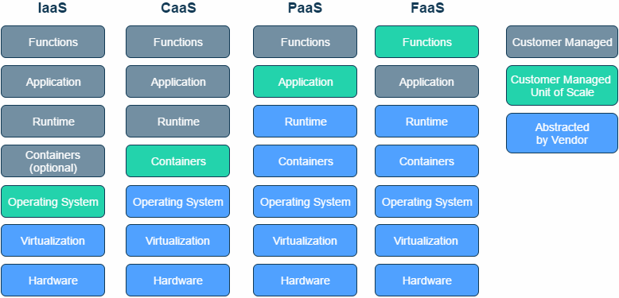
Service Model Comparison
Notes:
Source: https://serverless.zone/abstracting-the-back-end-with-faas-e5e80e837362
https://aws.amazon.com/compliance/shared-responsibility-model/
https://docs.microsoft.com/en-us/azure/security/fundamentals/shared-responsibility

Slide 25
Service Model Comparison
Hardware
Virtualization
Operating System
(Containers)
Runtime
Application
Function
On Premises
Hardware
Virtualization
Operating System
(Containers)
Runtime
Application
Function
IaaS
Hardware
Virtualization
Operating System
Containers
Runtime
Application
Function
PaaS
Hardware
Virtualization
Operating System
Containers
Runtime
Application
Function
SaaS
Customer Managed
Abstracted by Vendor
Customer Managed Unit Of Scale
Notes:
Source: https://serverless.zone/abstracting-the-back-end-with-faas-e5e80e837362
https://aws.amazon.com/compliance/shared-responsibility-model/
https://docs.microsoft.com/en-us/azure/security/fundamentals/shared-responsibility

Slide 26

Service Models
Infrastructure as a Service
The capability provided to the consumer is to provision processing, storage, networks, and other fundamental computing resources where the consumer is able to deploy and run arbitrary software, which can include operatin systems and applications. The consumer does not manage or control the underlying cloud infrastructure but has control over operating systems, storage, and deployed applications; and possibly limited control of select networking components (e.g., host firewalls).

Slide 27
Service Models
Infrastructure as a Service
Virtual Machines, Storage, Networking
E.g. OpenStack, vSphere, Azure Stack VMs

Slide 28

Service Models
Plattform as a Service
The capability provided to the consumer is to deploy onto the cloud infrastructure consumer-created or acquired applications created using programming languages, libraries, services, and tools supported by the provider.
The consumer does not manage or control the underlying cloud infrastructure including network, servers, operating systems, or storage, but has control over the deployed applications and possibly configuration settings for the application-hosting environment

Slide 29
Service Models
Plattform as a Service
Compute: OpenShift, CloudFoundry, Google App Engine, Azure AppService, Azure Data Fabric
Data: Amazon RDS, Azure SQL database, Azure Logic Apps
ML: Databricks, Dataiku, Azure ML Services, …

Slide 30
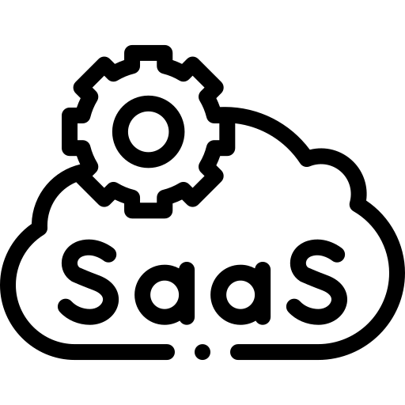
Service Models
Software as a Service
The capability provided to the consumer is to use the provider’s applications running on a cloud infrastructure. The applications are accessible from various client devices through either a thin client interface, such as a web browser (e.g., web-based email), or a program interface. The consumer does not manage or control the underlying cloud infrastructure including network, servers, operating systems, storage, or even individual application capabilities, with the possible exception of limited user-specific application configuration settings.

Slide 31
Service Models
Software as a Service
Google Workplace, Microsoft 365
Salesforce, SAP S/4HANA Cloud, Wordpress
GitHub, Terraform Cloud

Slide 32
Service Models
Modern

Slide 33
Service Model Comparison
Hardware
Virtualization
Operating System
(Containers)
Runtime
Application
Function
On Premises
Hardware
Virtualization
Operating System
(Containers)
Runtime
Application
Function
IaaS
Hardware
Virtualization
Operating System
Containers
Runtime
Application
Function
PaaS
Hardware
Virtualization
Operating System
Containers
Runtime
Application
Function
SaaS
Customer Managed
Abstracted by Vendor
Customer Managed Unit Of Scale
Notes:
Source: https://serverless.zone/abstracting-the-back-end-with-faas-e5e80e837362
https://aws.amazon.com/compliance/shared-responsibility-model/
https://docs.microsoft.com/en-us/azure/security/fundamentals/shared-responsibility

Slide 34
Service Model Comparison
Hardware
Virtualization
Operating System
(Containers)
Runtime
Application
Function
On Premises
Hardware
Virtualization
Operating System
(Containers)
Runtime
Application
Function
IaaS
Hardware
Virtualization
Operating System
Containers
Runtime
Application
Function
PaaS
Virtualization
Operating System
(Containers)
Runtime
Application
Function
SaaS
Customer Managed
Abstracted by Vendor
Customer Managed Unit Of Scale
Hardware
Virtualization
Operating System
Containers
Runtime
Application
Function
CaaS
Hardware
Notes:
Source: https://serverless.zone/abstracting-the-back-end-with-faas-e5e80e837362
https://aws.amazon.com/compliance/shared-responsibility-model/
https://docs.microsoft.com/en-us/azure/security/fundamentals/shared-responsibility

Slide 35
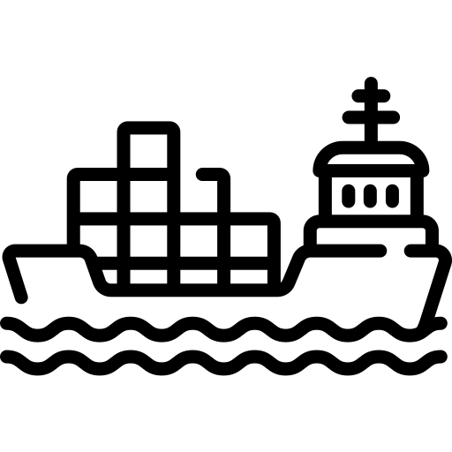
Service Models
Container as a Service
Is a form of container-based virtualization in which container engines, orchestration and the underlying compute resources are delivered to users as a service from a cloud provider.

Slide 36
Service Models
Container as a Service
Kubernetes
Google Container Engine
Amazon EC2 Container Service
Azure Kubernetes Service

Slide 37
Service Model Comparison
Hardware
Virtualization
Operating System
(Containers)
Runtime
Application
Function
On Premises
Hardware
Virtualization
Operating System
(Containers)
Runtime
Application
Function
IaaS
Hardware
Virtualization
Operating System
Containers
Runtime
Application
Function
PaaS
Hardware
Virtualization
Operating System
Containers
Runtime
Application
Function
SaaS
Customer Managed
Abstracted by Vendor
Customer Managed Unit Of Scale
Notes:
Source: https://serverless.zone/abstracting-the-back-end-with-faas-e5e80e837362
https://aws.amazon.com/compliance/shared-responsibility-model/
https://docs.microsoft.com/en-us/azure/security/fundamentals/shared-responsibility

Slide 38
Service Model Comparison
Hardware
Virtualization
Operating System
(Containers)
Runtime
Application
Function
On Premises
Hardware
Virtualization
Operating System
(Containers)
Runtime
Application
Function
IaaS
Hardware
Virtualization
Operating System
Containers
Runtime
Application
Function
PaaS
Hardware
Virtualization
Operating System
Containers
Runtime
Application
Function
SaaS
Customer Managed
Abstracted by Vendor
Customer Managed Unit Of Scale
Virtualization
Operating System
Containers
Runtime
Application
Function
FaaS
Hardware
Notes:
Source: https://serverless.zone/abstracting-the-back-end-with-faas-e5e80e837362
https://aws.amazon.com/compliance/shared-responsibility-model/
https://docs.microsoft.com/en-us/azure/security/fundamentals/shared-responsibility

Slide 39
Service Models
Function as a Service
FaaS is about running backend code without managing your own server systems or your own long-lived server applications.
Offerings do not require coding to a specific framework or library.
Deployment is different
Horizontal scaling is completely automatic, elastic and provider managed.
Functions are typically triggered by event types defined by the provider, e.g. inbound HTTP requests.
“Serverless computing”
Notes:
Source: https://martinfowler.com/articles/serverless.html#unpacking-faas

Slide 40
Service Models
Function as a Service
Examples:
AWS Lambda, Azure Function, Google Cloud Function

Slide 41
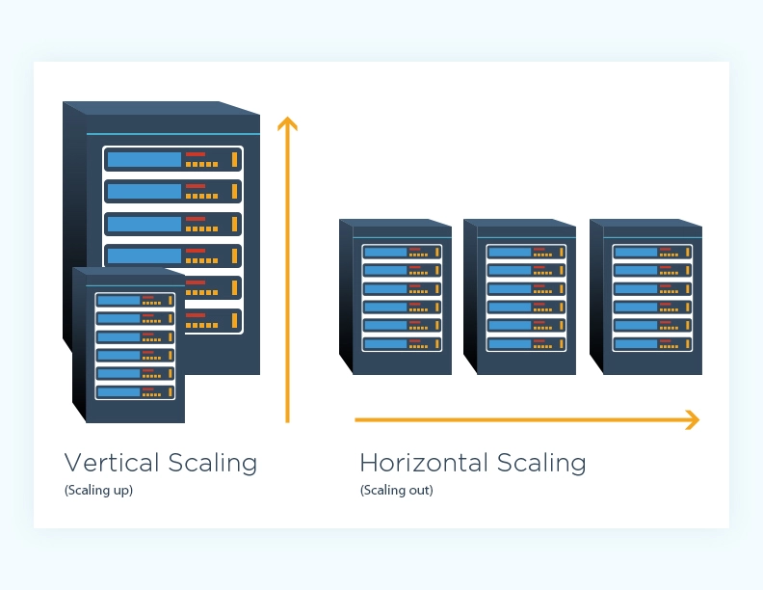
Excursus: Scale up and Scale out
Scale up (vertical scaling)
“Add additional resources”
Cheaper, less complex
Limited possibilities, less fault tolerant
Scale out (horizontal scaling)
“Add additional nodes”
Zero-downtime, increased resilience and performance
Increased complexity and initial costs
Notes:
Source: https://www.cloudzero.com/blog/horizontal-vs-vertical-scaling

Slide 42
Service Model Comparison
Hardware
Virtualization
Operating System
(Containers)
Runtime
Application
Function
On Premises
Hardware
Virtualization
Operating System
(Containers)
Runtime
Application
Function
IaaS
Hardware
Virtualization
Operating System
Containers
Runtime
Application
Function
PaaS
Hardware
Virtualization
Operating System
Containers
Runtime
Application
Function
SaaS
Customer Managed
Abstracted by Vendor
Customer Managed Unit Of Scale
Notes:
Source: https://serverless.zone/abstracting-the-back-end-with-faas-e5e80e837362
https://aws.amazon.com/compliance/shared-responsibility-model/
https://docs.microsoft.com/en-us/azure/security/fundamentals/shared-responsibility

Slide 43
Service Model Comparison
Hardware
Virtualization
Operating System
(Containers)
Runtime
Application
Function
On Premises
Hardware
Virtualization
Operating System
(Containers)
Runtime
Application
Function
IaaS
Hardware
Virtualization
Operating System
Containers
Runtime
Application
Function
PaaS
Hardware
Virtualization
Operating System
Containers
Runtime
Application
Function
SaaS
Customer Managed
Abstracted by Vendor
Customer Managed Unit Of Scale
Virtualization
Operating System
Containers
Runtime
Application
Function
BaaS
Hardware
Notes:
Source: https://serverless.zone/abstracting-the-back-end-with-faas-e5e80e837362
https://aws.amazon.com/compliance/shared-responsibility-model/
https://docs.microsoft.com/en-us/azure/security/fundamentals/shared-responsibility

Slide 44
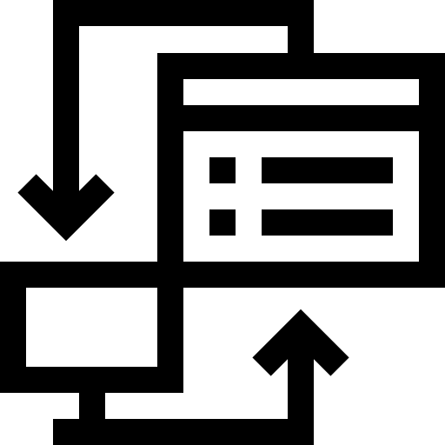
Service Models
Backend as a Service
Focused on backend aspects of solution, in contrast to SaaS which provides complete out of the box software.
Developer centric, customers can focus on frontend features.
Notes:
Source: https://serverless.zone/abstracting-the-back-end-with-faas-e5e80e837362

Slide 45
Service Models
Backend as a Service
Web/Mobile: Google Firebase, AWS Amplify
Authentication: Auth0, AWS Cognito
Messaging: Twilio, sendbird

Slide 46
Service Models
Summary
Are a basis for decision-making in the selection of suitable services.
There is often no exact classification of a service into a model.

Slide 47
Service Model “Pizza analogy”
On Premises
Infrastructure as a Service
Software as a Service
Container as a Service
Homemade
Communal kitchen
Bring your own
Plattorm as a Service
Takeaway
Function as a Service
Restaurant
Party
Notes:
Source: https://serverless.zone/abstracting-the-back-end-with-faas-e5e80e837362
https://aws.amazon.com/compliance/shared-responsibility-model/
https://docs.microsoft.com/en-us/azure/security/fundamentals/shared-responsibility

Slide 48
Adoption
Motivation, best practices, commercial aspects, governance

Slide 49
Cloud Enablers
Ubiquitous Networking (aka Internet)
Virtualization
Multi-Tenant Software Architecture

Slide 50
Cloud drivers
Beginnings
Cost savings due to outsourcing
Now
Innovation i.e., machine learning

Slide 51
Costs & Pricing

Slide 52
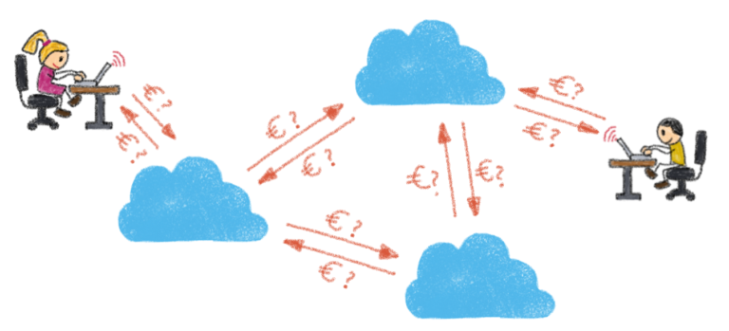
Cost components
Compute
CPUs, GPUs, specialized hardware
Storage
Storage services, attached storage
Networking
Ingress, Egress
Notes:
Source: https://spot.io/resources/cloud-cost-4-cost-models-and-6-cost-management-strategies/
Image: https://blog.ovhcloud.com/cloud-pricing-and-transparency-key-points-to-consider/

Slide 53
Pricing models: On-demand
On-demand or pay-per-use pricing is the simplest and mostly the default option at cloud providers. Customers pay exactly what they use.
Usage measure i.e., in hours, operations or service specific “units”.
Highest flexibility and most expensive.
Notes:
Source: https://www.exoscale.com/syslog/cloud-pricing-models/

Slide 54
Pricing models: Spot
Spot instances are used by cloud providers to sell off spare capacity. The discount comes with a catch—spot instances can be interrupted at very short notice.
Based on an auction-based system. Customers bid for instances and as soon as the market price drops below the bid, the instance is “bought” at the market price (not the bidding price).
High potential savings, complex management. Stateless, fault tolerant, time independent workloads.
Notes:
Source: https://www.exoscale.com/syslog/cloud-pricing-models/

Slide 55
Pricing models: Reserved instance
Reserved instances allow companies to commit to cloud resources for a long period of time, often one to three years.
Steady state and long running workloads. Not suitable for peak loads.
Notes:
Source: https://www.exoscale.com/syslog/cloud-pricing-models/

Slide 56
Pricing models: Tiers or Volume
Vendor specific discounts depending on the actual and / or committed consumption. Often come with hybrid payment terms; upfront and recurring payments.
Notes:
Source: https://www.exoscale.com/syslog/cloud-pricing-models/

Slide 57
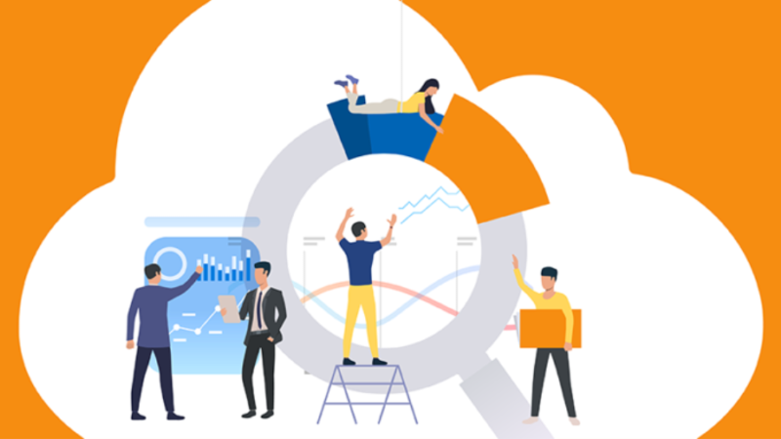
Cost management
Budget control
Right sizing
Autoscaling
Scheduling
Detect unused resources
Use discounts
Notes:
Source: https://spot.io/resources/cloud-cost-4-cost-models-and-6-cost-management-strategies/
Image: https://blog.dxcloudsuite.io/top-it-and-cloud-cost-management-challenges/

Slide 58
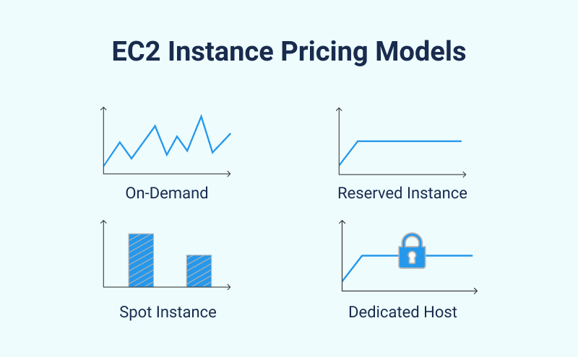
On-demand Pricing
Notes:
Source: https://www.msp360.com/resources/blog/amazon-ec2-instances-pricing-explained/

Slide 59
Best practices

Slide 60
How to start
Start small
One workload
Few service types

Slide 61
Cloud Strategy & Tactics
Strategy
Plan your cloud usage
Vendor and service focus
E.g. one general purpose provider; specific SaaS providers
Define goals, measures, organization and responsibilities
Tactics
Keep learning
Define your technology compass
Do things right

Slide 62
Azure by Example
How Azure works, building blocks

Slide 63
Note
Major cloud providers use similar concepts
Azure was only chosen as an example for illustration purposes

Slide 64
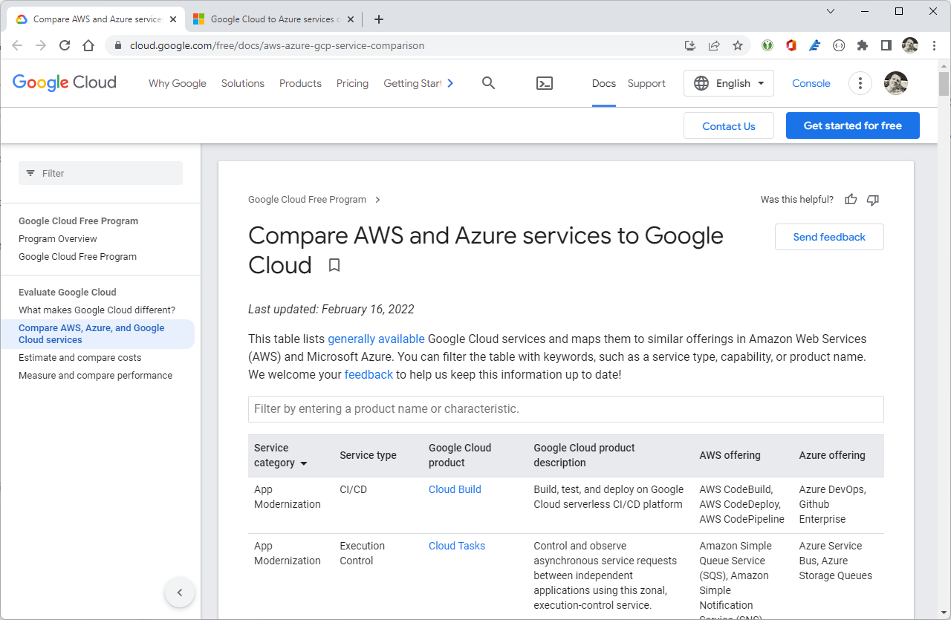
Comparison guidelines
Notes:
Sources:
https://cloud.google.com/free/docs/aws-azure-gcp-service-comparison
https://docs.microsoft.com/en-us/azure/architecture/gcp-professional/services

Slide 65

Virtualization
Three types of virtualization
Compute: CPU
Storage: Disk and Memory
Connectivity: Network, Switches, Load Balancer, …
Notes:
Source: https://docs.microsoft.com/en-us/azure/cloud-adoption-framework/get-started/what-is-azure

Slide 66
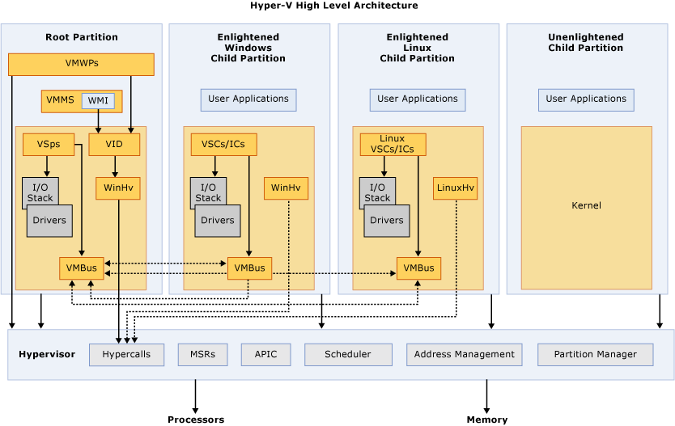
Hypervisor
Notes:
Source: https://docs.microsoft.com/en-us/virtualization/hyper-v-on-windows/reference/hyper-v-architecture

Slide 67
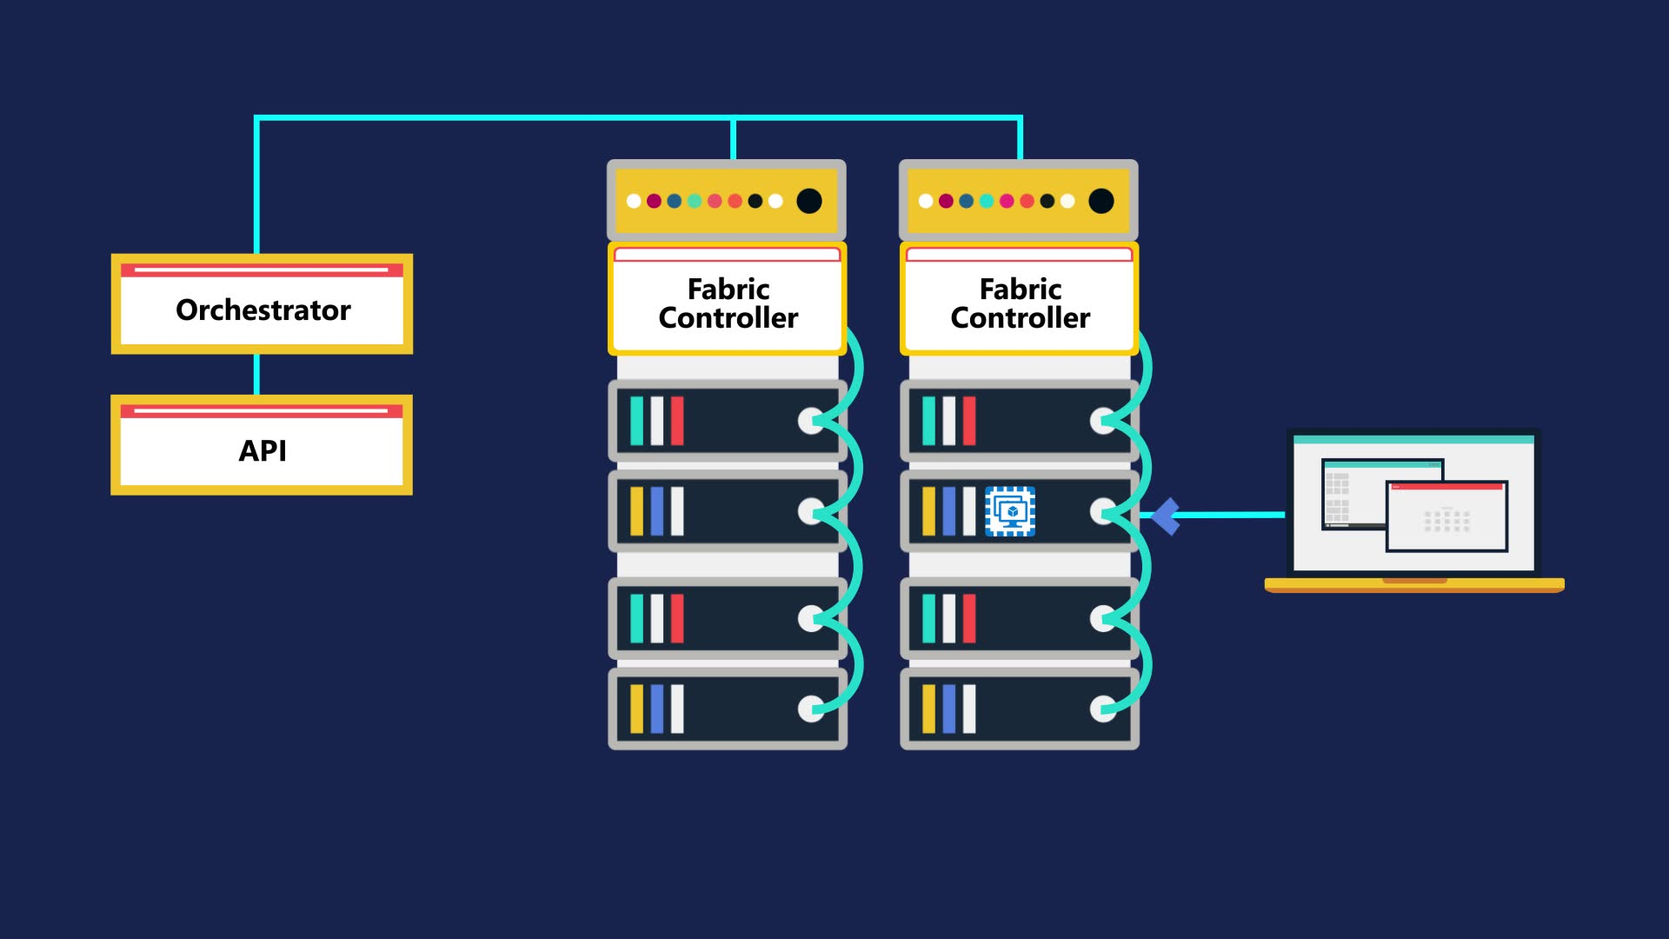
How does Azure work?
Notes:
Source: https://docs.microsoft.com/en-us/azure/cloud-adoption-framework/get-started/what-is-azure
Glue to user frontent: orchestrator and fabric controller

Slide 68
Structuring resources
Data centers, zones, regions, scopes

Slide 69
Physical structure
Infrastructure perspective
Azure Geography
Azure Region
Availability Zone
Availability Set
Notes:
Source: https://docs.microsoft.com/en-us/azure/architecture/aws-professional/regions-zones

Slide 70
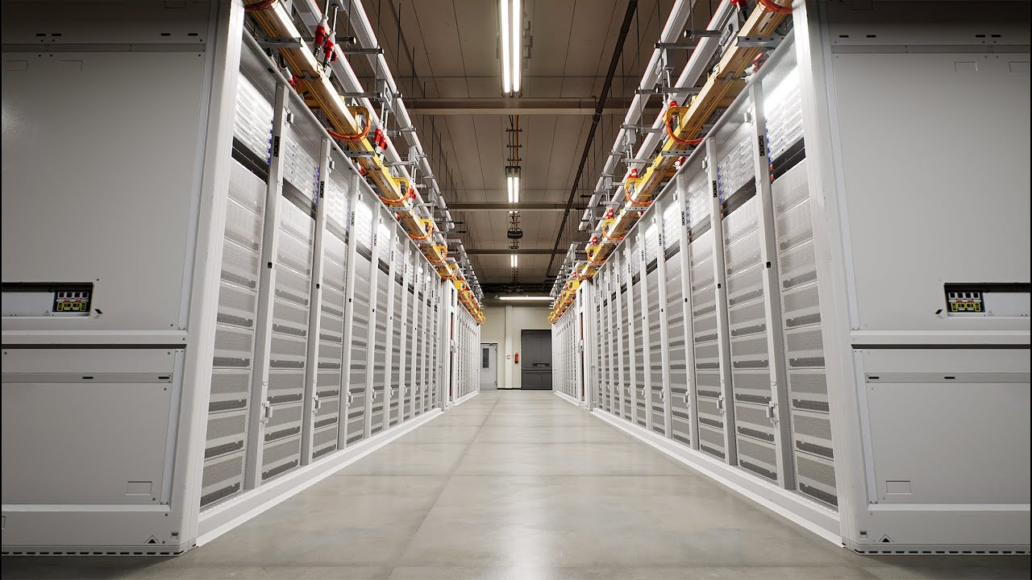
Availability Zone
Notes:
Source: https://news.microsoft.com/stories/microsoft-datacenter-tour/

Slide 71
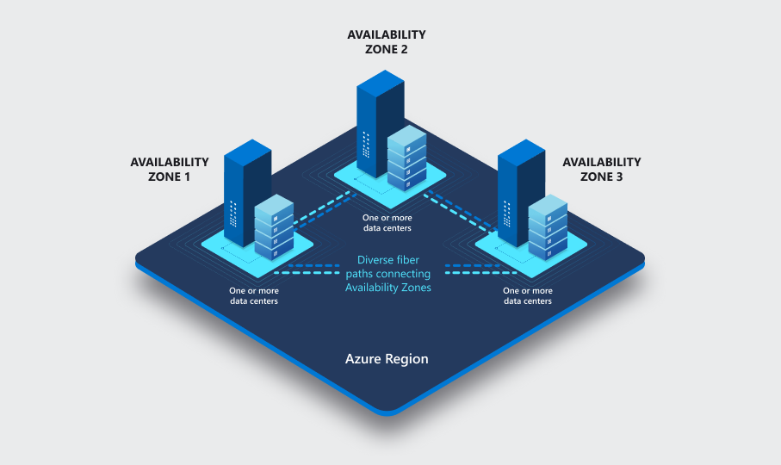
Azure Region
Notes:
Source: https://docs.microsoft.com/en-us/azure/availability-zones/az-overview

Slide 72
Azure Region
Notes:
Source: https://docs.microsoft.com/en-us/azure/availability-zones/az-overview

Slide 73
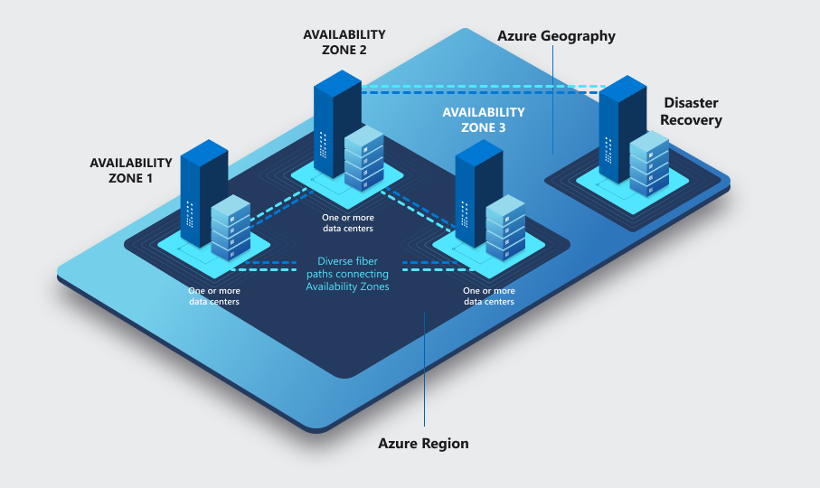
Azure Geography
Notes:
Source: https://docs.microsoft.com/en-us/azure/availability-zones/az-overview

Slide 74
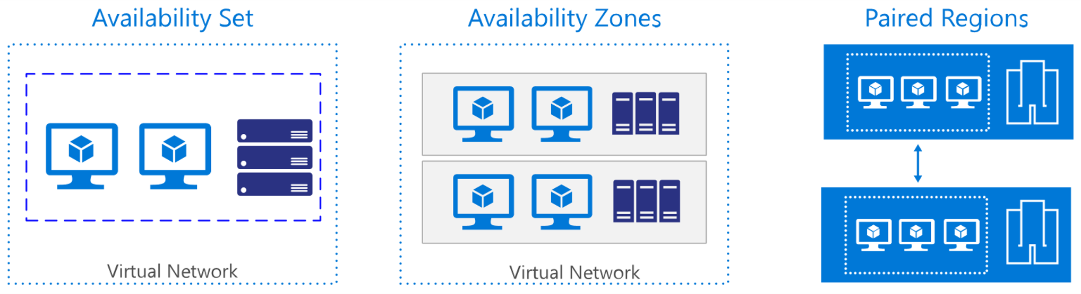
Availability Set & Zones
Notes:
Source: https://docs.microsoft.com/en-us/azure/architecture/aws-professional/regions-zones

Slide 75
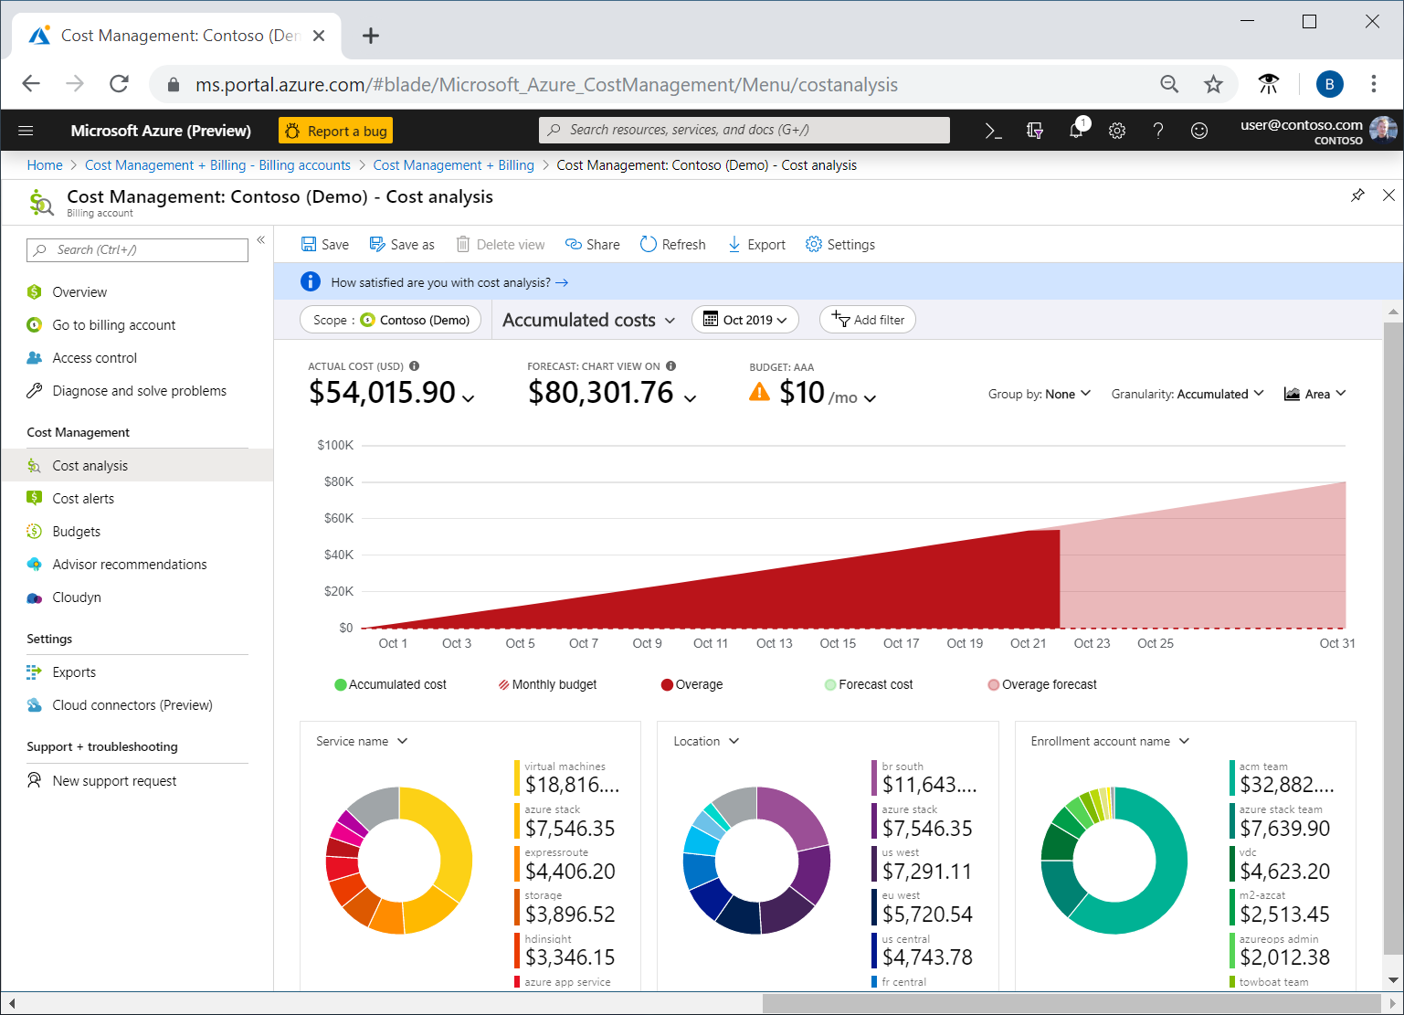
Logical structure
Organizational perspective
Responsibility
Billing perspective
Costs, Limits and Quotas
Notes:
Image: https://docs.microsoft.com/en-us/azure/cost-management-billing/costs/quick-acm-cost-analysis

Slide 76
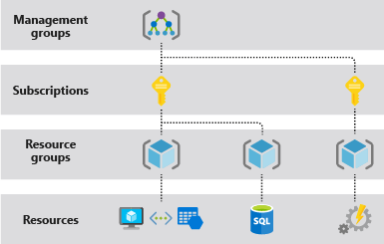
Azure levels of Scope

Slide 77
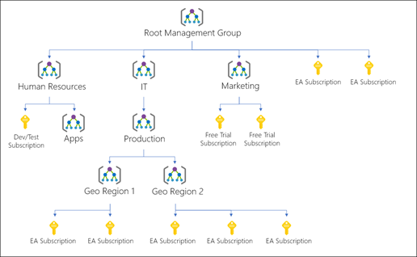
Management groups
Provide enterprise-grade management
Hierarchical containers
Organize subscriptions

Slide 78
Subscription
logically associate user accounts with the resources they create
has limits or quotas on the amount of resources it can create and use
Organizations can use subscriptions to manage costs and the resources created by users, teams, or projects.
Notes:
Source: https://docs.microsoft.com/en-us/azure/cloud-adoption-framework/ready/azure-setup-guide/organize-resources

Slide 79
Resource groups
are logical containers where you can deploy and manage Azure resources like web apps, databases, and storage accounts.

Slide 80
Scopes
Summary
Typically, you only see subscriptions, resource groups and resources
“Cut” of subscription and resource groups often based on cost center or service responsibility
Management groups mostly used by “really” large organizations
Notes:
Source: https://docs.microsoft.com/en-us/azure/governance/management-groups/overview

Slide 81
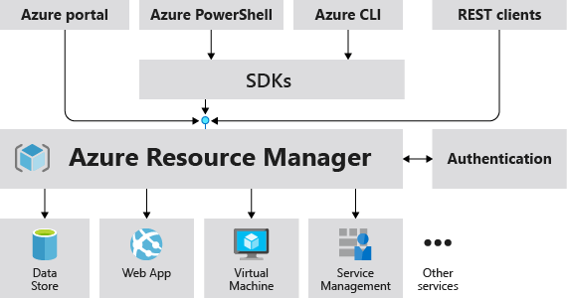
Management Layer
Notes:
Source: https://docs.microsoft.com/en-us/azure/azure-resource-manager/management/overview

Slide 82
Tooling

Slide 83
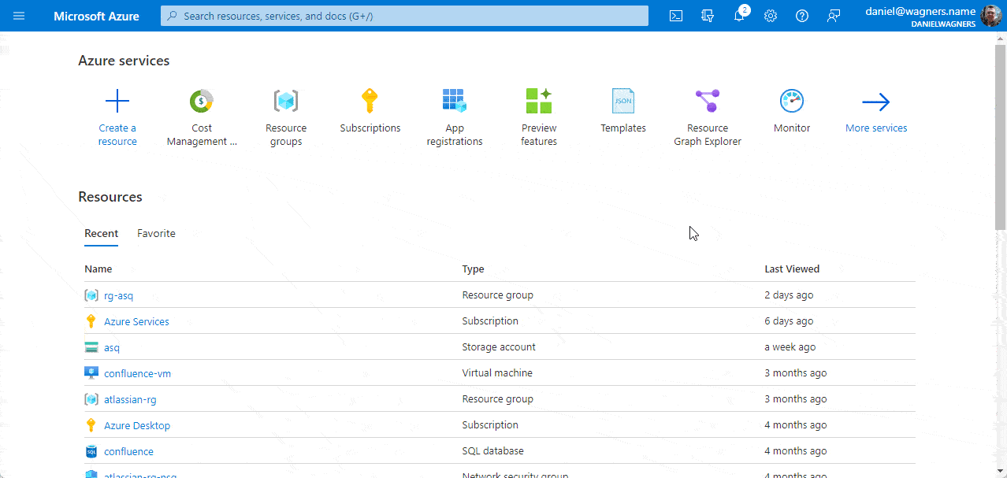
Azure Portal
Browser based Management Portal for Azure
Create, Manage and Monitor all Azure resources and applications
Efficient navigation via Search
Centers around resource management panes called Blades
Notes:
Source: https://docs.microsoft.com/en-us/azure/cloud-shell/overview

Slide 84
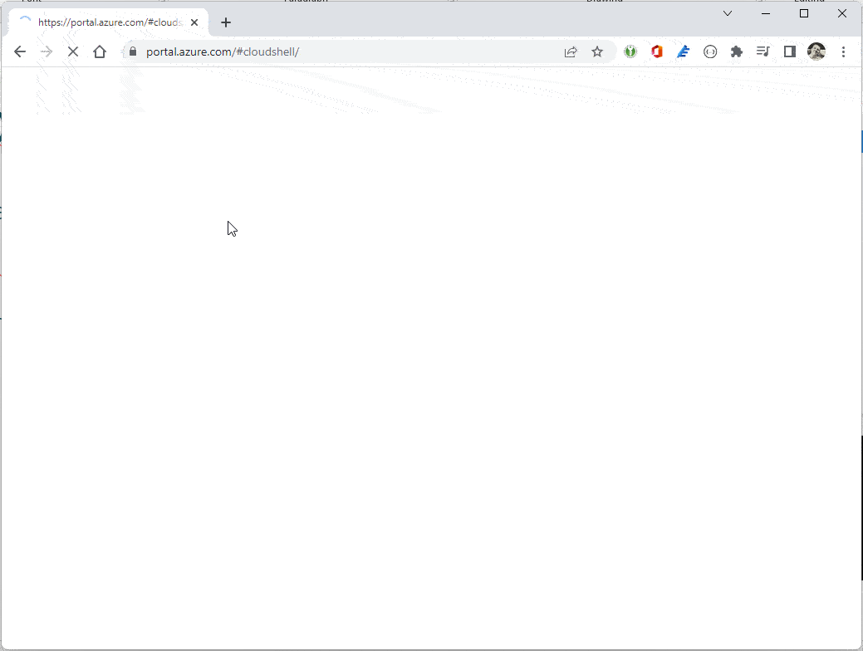
Azure Cloud Shell
Interactive, authenticated, browser-accessible shell for managing Azure resources.
Provides either Bash or PowerShell
Persistent clouddrive available
Notes:
Source: https://docs.microsoft.com/en-us/azure/cloud-shell/overview

Slide 85
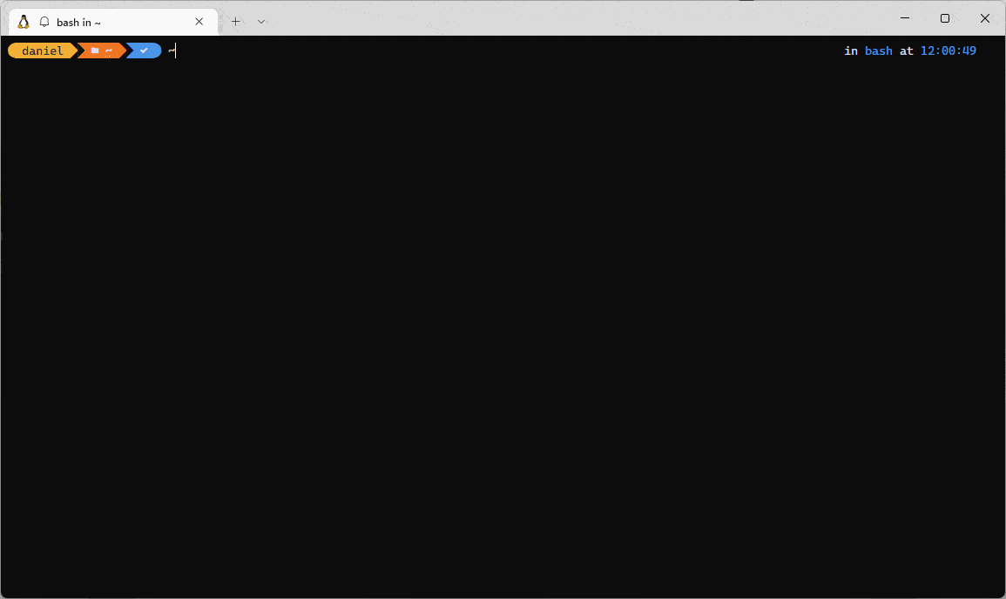
Azure CLI
The Azure command-line interface (Azure CLI) is a set of commands used to create and manage Azure resources. The Azure CLI is available across Azure services and is designed to get you working quickly with Azure, with an emphasis on automation.
Notes:
Source: https://docs.microsoft.com/en-us/cli/azure/

Slide 86
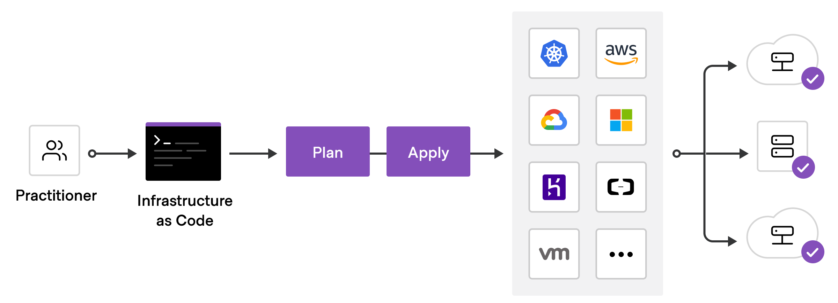
Infrastructure as Code - IaC
Manage infrastructure with configuration files instead of user interfaces
Allows to build, change, and manage infrastructure in a safe, consistent, and repeatable way by defining resource configurations that be versioned, reused, and shared.
Notes:
Source: https://learn.hashicorp.com/tutorials/terraform/infrastructure-as-code

Slide 87
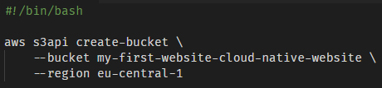
Imperative IaC
Programmatic (procedural) approach
Describes how resources are configured
Notes:
Source: https://learn.hashicorp.com/tutorials/terraform/infrastructure-as-code

Slide 88
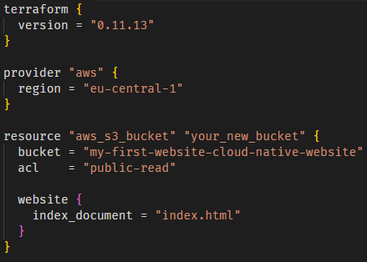
Declarative IaC
Describe the desired state of resources and their configuration
Tooling decides how to achieve the state
Notes:
Source: https://learn.hashicorp.com/tutorials/terraform/infrastructure-as-code

Slide 89




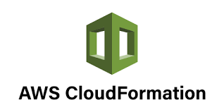
Infrastructure as Code Tooling
Many tools available
Open-source, freemium, proprietary
Cloud agnostic or specific
Notes:
Source: https://learn.hashicorp.com/tutorials/terraform/infrastructure-as-code

Slide 90
Experimentation

Slide 91
Cloud is
... so much more than just computers ;-)

Slide 92
Homework
I hear and I forget. I see and I remember. I do and I understand. (Confucius)

Slide 93

Task One
You meet your boss in the elevator and he asks:
“I’ve heard about PaaS and CaaS, what’s the difference and which would you use for our project”
Answer in your own words (remember the elevator!), give a brief outline of your real or fictional project.
Notes:
Source: https://www.wdrmaus.de/filme/mausspots/paternoster.php5

Slide 94
Task Two
Create a free Azure account.
IaaS
Provision a virtual machine and connect via SSH. Make some screenshots.
PaaS
Provision a service bus instance, create a queue, connect with Service Bus Explorer, submit some test messages, look at the queue.
Extra: Use a Bicep script instead of portal.
Documentation
If you prefer AWS or GCP go for it, just use matching services

